Slide 1
Capstone Project -2 Retail Sales prediction by- Souvik Bhattacharyya

Slide 2
Content
Abstract
Dataset summary
Data summary
Exploratory Data prediction
EDA For a Rossmann sales prediction
Training and testing Dataset
Modeling
Linear Regression
Lasso Regularization
Decision Tree Regressor
Conclusion

Slide 3
Abstract
This project deals with businesses that use sales forecasts. Rossmann store managers are tasked with predicting their daily sales up to six weeks in advance. Store sales are influenced by many factors, including promotions, competition, school and state holidays, seasonality, and locality. With thousands of individual managers predicting sales based on their unique circumstances, the accuracy of the results can be quite varied. what revenue they will generate during a specific time period and arm themselves with powerful and strategic business plans. Growth plans are affected by the revenue the company is going to make in the coming months, and for these plans to be as effective as they are planned to be, it is important for these forecasts to also be as good. The work here predicts the sales for a drugstore chain in the European market for a time period of six weeks and compares the results of different machine learning algorithms.

Slide 4
Dataset Summary
In the Rossmann sales prediction project there is a dataset which contains sales information.
There are two dataset that is Rossmann Store dataset and Store dataset.
Rossmann Store dataset has 1017209 rows and 8 columns whereas Store dataset has 1115 rows and 10 columns.
Data contain information on Sales, Customers, Assortments, State Holidays,
School Holidays, Promotions etc.

Slide 5
Data Summary
Id - an Id that represents a (Store, Date) duple within the set
Store - a unique Id for each store
Sales - the turnover for any given day (Dependent Variable)
Customers - the number of customers on a given day
Open - an indicator for whether the store was open: 0 = closed, 1 = open
StateHoliday - indicates a state holiday. Normally all stores, with few exceptions, are closed on state holidays. Note that all schools are closed on public holidays and weekends. a = public holiday, b = Easter holiday, c = Christmas, 0 = None
SchoolHoliday -indicates if the (Store, Date) was affected by the closure of public schools
StoreType-differentiates between 4 different store models: a, b, c, d
Assortment -describes an assortment level: a = basic, b = extra, c = extended. An assortment strategy in retailing involves the number and type of products that stores display for purchase by consumers.
CompetitionDistance-distance in meters to the nearest competitor store
CompetitionOpenSince[Month/Year] -gives the approximate year and month of the time the nearest competitor was opened
Promo -indicates whether a store is running a promo on that day
Promo2 -Promo2 is a continuing and consecutive promotion for some stores: 0 = store is not participating, 1 = store is participating
Promo2Since[Year/Week] -describes the year and calendar week when the store started participating in Promo2
PromoInterval-describes the consecutive intervals Promo2 is started, naming the months the promotion is started anew. E.g. "Feb,May,Aug,Nov" means each round starts in February, May, August, November of any given year for that store.

Slide 6
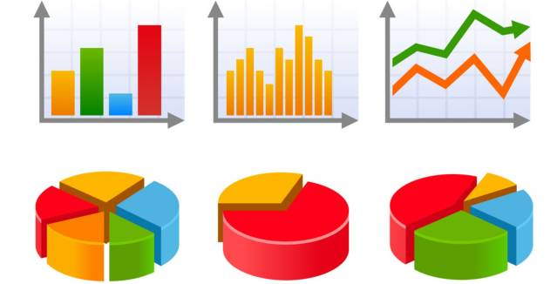
Exploratory Data Analysis
Exploratory Data Analysis also known as EDA, is the process of interpreting datasets by summarizing their key properties.
EDA refers to the critical process of performing initial investigation on datasets so as discover the patterns, spot anomalies, to the hypothesis, and check assumptions with the help of summary statics and graphical representation.

Slide 7
Exploratory Data Analysis
Just by observing the head of the dataset and understanding the features involved in it, the following could be framed:
There's a feature called "DayOfWeek" with the values 1-7 denoting each day of the week. There would be a week off probably Sunday when the stores would be closed and we would get low overall sales.
Customers would have a positive correlation with Sales.
The Store type and Assortment strategy involved would be having a certain effect on sales as well. Some premium high quality products would fetch more revenue.
Promotion should be having a positive correlation with Sales.
Some stores are closed due to refurbishment, those would generate 0 revenue for that time period.
There would be would be high. some seasonality involved in the sales pattern, probably before holidays sales

Slide 8
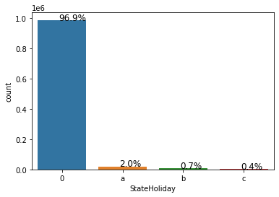
State Holiday
We can see 96.9 % of stores are closed on state holidays.
2% of stores are not closed during public holidays.
0.7% of stores are not closed on Easter holidays.
0.45% of stores are not closed on Christmas.

Slide 9
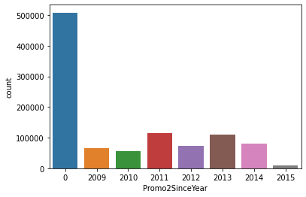
Promo2Since year
We can maximum stores have not participated in promo2 .
In participated stores year 2011 highest number of stores participated.
In 2015 lowest participation was done for promo 2.

Slide 10
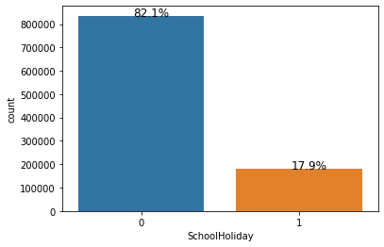
School Holidays
We can see 82.1 % of stores are not affected due to the school holiday.
Whereas 17.9% of stores are affected during school holidays.

Slide 11
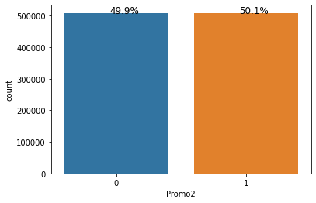
Promo 2
We can see 49.9% have not participated in promo 2 whereas 51.1% have participated in prom02. which is approximately equally numbers of stores have participated as well as not participated in promo 2.

Slide 12
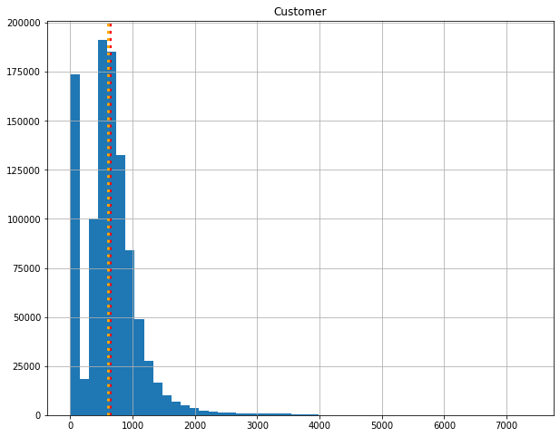
Customers
We can see customers for stores range from 0 to 4000.
The mean is shown with a red dotted line and the median is shown with an orange dotted line.
We can see that the mean and median are nearly the same numbers.

Slide 13
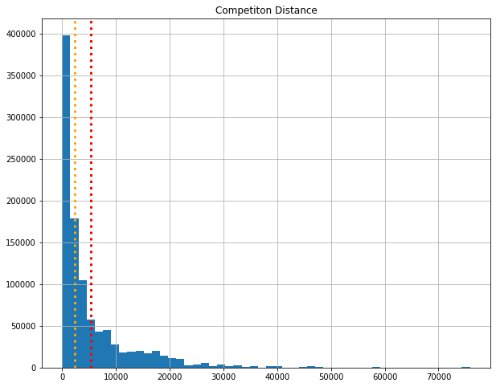
Competition Distance
We can see competition distance for stores ranges from 0 to 7000.
The mean is shown with a red dotted line and the median is shown with an orange dotted line.
We can see that the mean and median have different numbers which means there is an outlier in the competition distance columns.

Slide 14
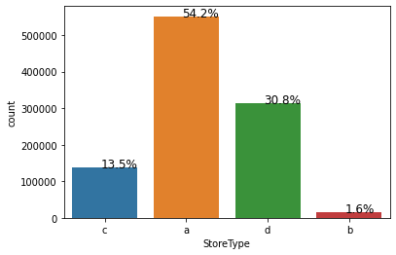
Store Type
We can see that store types a has 54.2% and d account for 30.8% of all stores, while stores types c and b account for 13.5% and 1.6% respectively. Retail stores could be the most common form of store, which would explain why there might be a lot of them. Type B could be a distributor, Type C could be a wholesaler, and Type B could be a retail wholesaler.

Slide 15
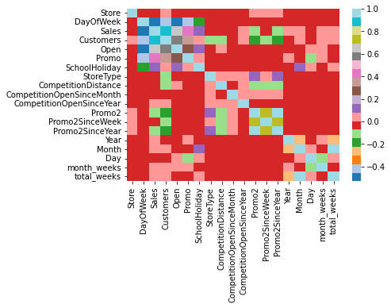
Correlation Between Features and Dependent variable
We can see a correlation between the dependent variable and the features, we can get an image of what will have a high and low number of correlation with the sale.
We can see that customer and Open columns have a very strong correlation with the sales column.

Slide 16
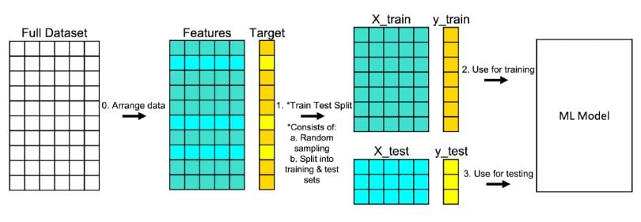
Splitting dataset in train and test dataset
The train-test split is used to estimate the performance of machine learning algorithms that are applicable to prediction-based Algorithms/Applications. This method is a fast and easy procedure to perform such that we can compare our own machine-learning model results to machine results. We have split the Test set into 20 % of the actual data and the training set is split into 80% of the actual data.
We need to split a dataset into train and test sets to evaluate how well our machine-learning model performs. The train set is used to fit the model, and the statistics of the train set are known. The second set is called the test data set, this set is solely used for predictions.

Slide 17
Modeling
Linear Regression:
In statistics, linear regression is a linear approach for modeling the relationship between a scalar response and one or more explanatory variables. The case of one explanatory variable is called simple linear regression; for more than one, the process is called multiple linear regression.
The results show that in Linear regression it is performing not well and the r2 score is 0.86

Slide 18
Linear Regression using lasso regularization:
Lasso regression is a regularization technique. It is used over regression methods for a more accurate prediction. This model uses shrinkage. Shrinkage is where data values are shrunk towards a central point as the mean. The lasso procedure encourages simple, sparse models (i.e. models with fewer parameters). This particular type of regression is well-suited for models showing high levels of multicollinearity or when you want to automate certain parts of model selection, like variable selection/parameter elimination.
Lasso Regression uses the L1 regularization technique. It is used when we have more features because it automatically performs feature selection.
The results show that in Lasso Regularization is also not performing well and the r2 score is 0.85

Slide 19
Decision Tree Regressor
Decision Tree is a Supervised learning technique that can be used for both Classification and Regression problems. It is a tree-structured classifier, where internal nodes represent the features of a dataset, branches represent the decision rules and each leaf node represents the outcome.
The results show that a simple decision tree is performing pretty well on the validation set but it has completely overfitted the train set. It's better to have a much more generalized model for future data points.
The results show that Decision Trees performed well and the r2 score is 0.97.

Slide 20
Conclusion
After implementing three machine learning models in the dataset to find the six-week prediction we can find that the Decision Tree regressor has the best accuracy among the other two models which underperformed as they haven’t given a good accuracy for prediction whereas the Decision Tree regressor has 97% of accuracy which is a descent accuracy score and the prediction can be done using the model.

Slide 21
THANK YOU

